Slide 2
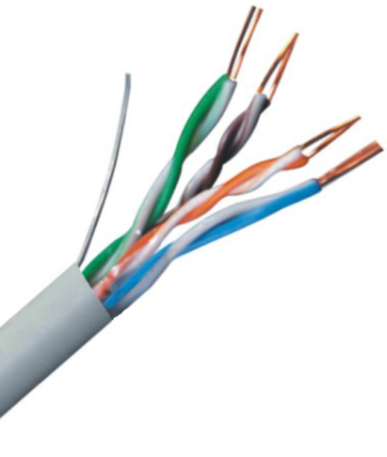
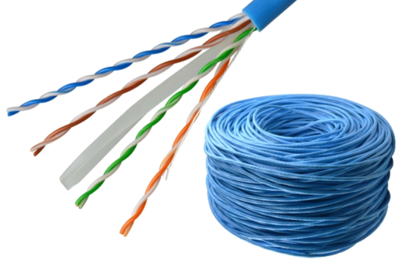
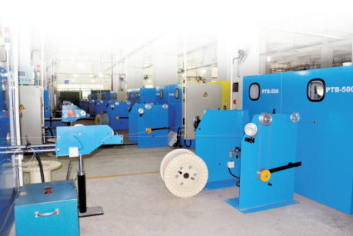
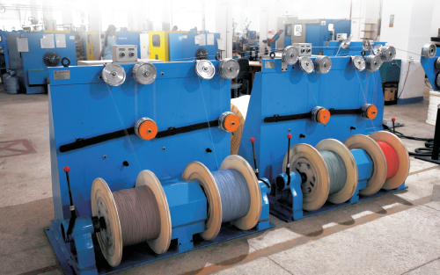
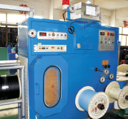
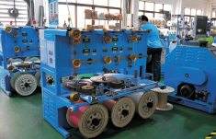
CAT5E & CAT6 Lan Cable
SPECIFICATION:
Conductor: Bare Solid Copper
CAT5E: 0.50mm(24AWG)
CAT6: 0.57mm(23AWG), 0.51mm(24AWG)
UTP(Unshielded Twisted Pair),
FTP(Shielded Foil Twisted Pair),
Jacket: PVC, LSZH
Application: PC, ADSL, network Module Plate, Wall Socket
Packaging: REELEX BOX

Slide 3
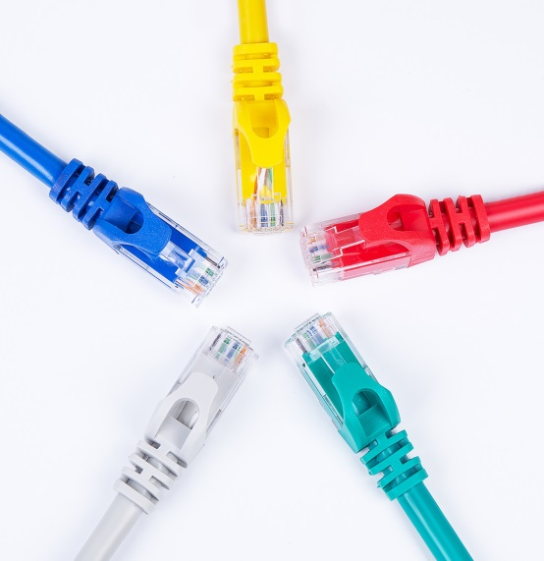
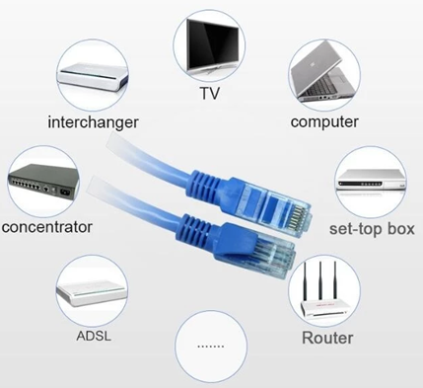
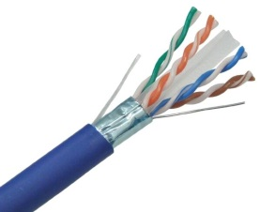
CAT6A Lan Cable & Patch Cable
Patch Cable
Indoor and Outdoor CAT6A (10G)
- Suitable for computers and switches, hubs, ADSL, router, data set-top box, TV with cable interface and wireless network jumper with connection between network devices.
-U/FTP CAT6A 4*2*23AWG LSZH
-Frequency: 500MHz
-Suitable for structured premises cabling; For transmission of digital and analogue voice and data signals.
-Especially suitable for all Class EA applications.
-ISDN,Ethernet 10 Base-T,Fast Ethernet 100 Base-T,Gigabit Ethernet 1000Base-T ,10G Base-T.
(IEEE 802.3)
Package:

